Slide 1
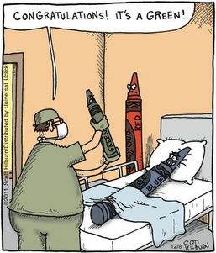
Colors
Computers build colors from Red, Green, and Blue; not Red, Blue, and Yellow.
  RGB = Red Green Blue
Creating Colors
  Red + Blue = Purple
  No Red, No Green, and No Blue = Black
  Max RGB values = White
  equal mix of RGB = gray

Slide 2
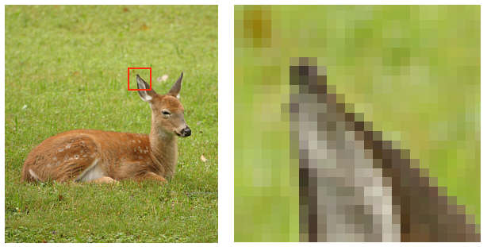
Image Files
http://photo.net/equipment/digital/basics/
Notes:
How jpeg image compression works.

Slide 3
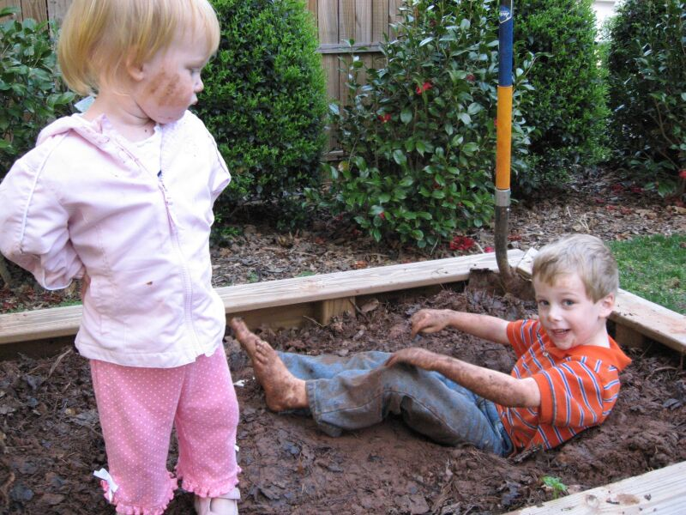
800 x 600 pixels
117 KB
Notes:
Picture of my kids helping me plant tomatoes.
Check out the look on Claire's face: "Boys are stupid".

Slide 4
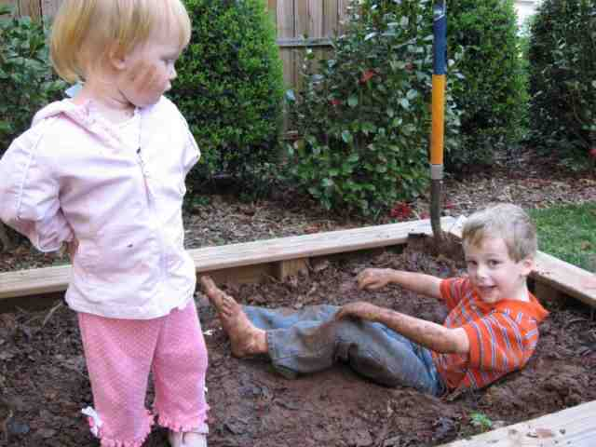
640 x 480 pixels
26.6 KB
Notes:
This is image file is ¼ the size of the previous image. But, you probably can't tell.

